Slide 1
Greedy Alogirthm

Slide 2

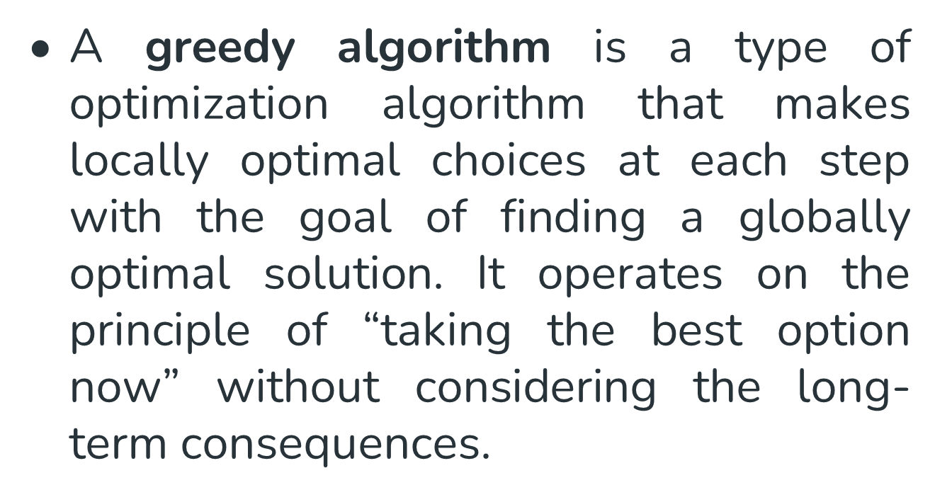

Slide 3

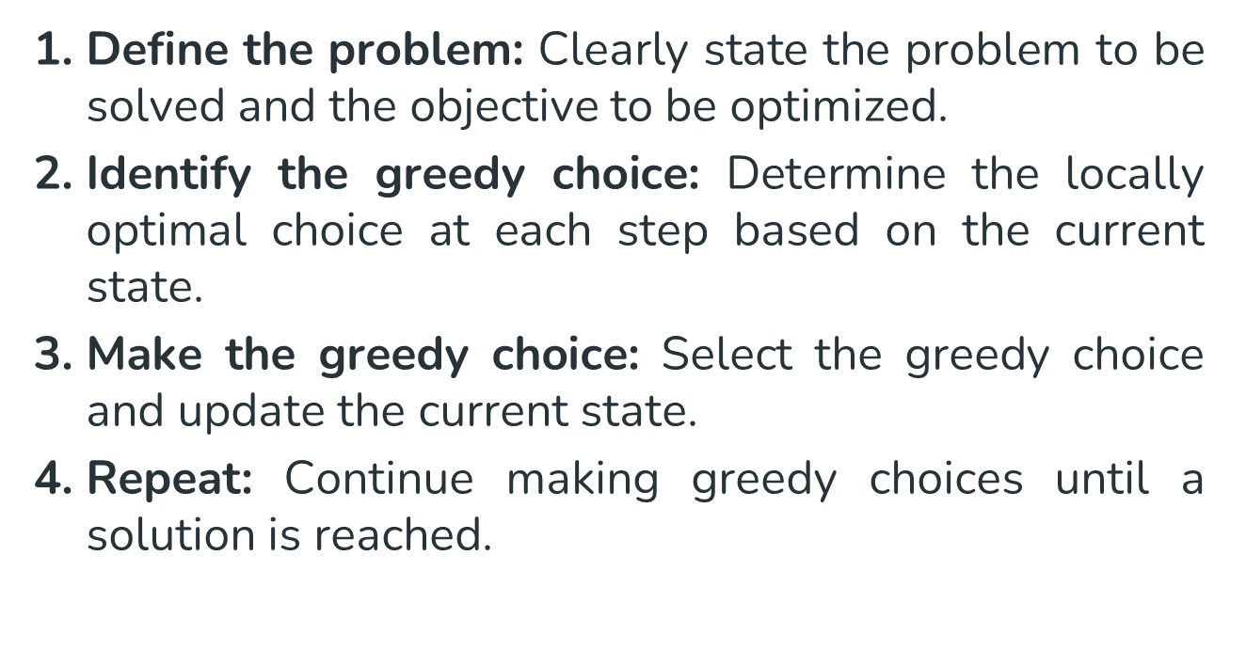

Slide 4
Huffman Coding using Greedy approach

Slide 5
Encoding and Compression of Data
Fax Machines
ASCII
Variations on ASCII
  min number of bits needed
  cost of savings
  patterns
  modifications

Slide 6
Purpose of Huffman Coding
Proposed by Dr. David A. Huffman in 1952
  “A Method for the Construction of Minimum Redundancy Codes”
Applicable to many forms of data transmission
  Our example: text files
Notes:
An Introduction to Huffman Coding
March 21, 2000
Mike Scott

Slide 7
The Basic Algorithm
Huffman coding is a form of statistical coding
Not all characters occur with the same frequency!
Yet all characters are allocated the same amount of space
  1 char = 1 byte, be it e or x
Notes:
An Introduction to Huffman Coding
March 21, 2000
Mike Scott

Slide 8
The Basic Algorithm
Any savings in tailoring codes to frequency of character?
Code word lengths are no longer fixed like ASCII.
Code word lengths vary and will be shorter for the more frequently used characters.
Notes:
An Introduction to Huffman Coding
March 21, 2000
Mike Scott

Slide 9
The (Real) Basic Algorithm
1. Scan text to be compressed and tally occurrence of all characters.
2. Sort or prioritize characters based on number of occurrences in text.
3. Build Huffman code tree based on prioritized list.
4. Perform a traversal of tree to determine all code words.
5. Scan text again and create new file using the Huffman codes.
Notes:
An Introduction to Huffman Coding
March 21, 2000
Mike Scott

Slide 10
Building a Tree
Scan the original text
Consider the following short text:
Eerie eyes seen near lake.
Count up the occurrences of all characters in the text
Notes:
An Introduction to Huffman Coding
March 21, 2000
Mike Scott

Slide 11
Building a Tree
Scan the original text
Eerie eyes seen near lake.
What characters are present?
E e r i space
y s n a r l k .
Notes:
An Introduction to Huffman Coding
March 21, 2000
Mike Scott

Slide 12
Building a Tree
Scan the original text
Eerie eyes seen near lake.
What is the frequency of each character in the text?
Char Freq. Char Freq. Char Freq.
E 1 y 1 k 1
e 8 s 2 . 1
r 2 n 2
i 1 a 2
space 4 l 1
Notes:
An Introduction to Huffman Coding
March 21, 2000
Mike Scott

Slide 13
Building a Tree
Prioritize characters
Create binary tree nodes with character and frequency of each character
Place nodes in a priority queue
  The lower the occurrence, the higher the priority in the queue
Notes:
An Introduction to Huffman Coding
March 21, 2000
Mike Scott

Slide 14
Building a Tree
Prioritize characters
Uses binary tree nodes
public class HuffNode
{
public char myChar;
public int myFrequency;
public HuffNode myLeft, myRight;
}
priorityQueue myQueue;
Notes:
An Introduction to Huffman Coding
March 21, 2000
Mike Scott

Slide 15
Building a Tree
The queue after inserting all nodes
Null Pointers are not shown
E
1
i
1
y
1
l
1
k
1
.
1
r
2
s
2
n
2
a
2
sp
4
e
8
Notes:
An Introduction to Huffman Coding
March 21, 2000
Mike Scott

Slide 16
Building a Tree
While priority queue contains two or more nodes
  Create new node
  Dequeue node and make it left subtree
  Dequeue next node and make it right subtree
  Frequency of new node equals sum of frequency of left and right children
  Enqueue new node back into queue
Notes:
An Introduction to Huffman Coding
March 21, 2000
Mike Scott

Slide 17
Building a Tree
E
1
i
1
y
1
l
1
k
1
.
1
r
2
s
2
n
2
a
2
sp
4
e
8
Notes:
An Introduction to Huffman Coding
March 21, 2000
Mike Scott

Slide 18
Building a Tree
y
1
l
1
k
1
.
1
r
2
s
2
n
2
a
2
sp
4
e
8
2
E
1
i
1
Notes:
An Introduction to Huffman Coding
March 21, 2000
Mike Scott

Slide 19
Building a Tree
y
1
l
1
k
1
.
1
r
2
s
2
n
2
a
2
2
sp
4
e
8
E
1
i
1
Notes:
An Introduction to Huffman Coding
March 21, 2000
Mike Scott

Slide 20
Building a Tree
k
1
.
1
r
2
s
2
n
2
a
2
2
sp
4
e
8
E
1
i
1
2
y
1
l
1
Notes:
An Introduction to Huffman Coding
March 21, 2000
Mike Scott

Slide 21
Building a Tree
k
1
.
1
r
2
s
2
n
2
a
2
2
2
sp
4
e
8
y
1
l
1
E
1
i
1
Notes:
An Introduction to Huffman Coding
March 21, 2000
Mike Scott

Slide 22
Building a Tree
r
2
s
2
n
2
a
2
2
2
sp
4
e
8
y
1
l
1
E
1
i
1
2
k
1
.
1
Notes:
An Introduction to Huffman Coding
March 21, 2000
Mike Scott

Slide 23
Building a Tree
r
2
s
2
n
2
a
2
2
2
sp
4
e
8
2
E
1
i
1
y
1
l
1
k
1
.
1
Notes:
An Introduction to Huffman Coding
March 21, 2000
Mike Scott

Slide 24
Building a Tree
n
2
a
2
2
sp
4
e
8
2
2
E
1
i
1
y
1
l
1
k
1
.
1
4
r
2
s
2
Notes:
An Introduction to Huffman Coding
March 21, 2000
Mike Scott

Slide 25
Building a Tree
n
2
a
2
2
sp
4
e
8
2
2
4
E
1
i
1
y
1
l
1
k
1
.
1
r
2
s
2
Notes:
An Introduction to Huffman Coding
March 21, 2000
Mike Scott

Slide 26
Building a Tree
2
4
e
8
2
2
sp
4
y
1
l
1
k
1
.
1
r
2
s
2
E
1
i
1
4
n
2
a
2
Notes:
An Introduction to Huffman Coding
March 21, 2000
Mike Scott

Slide 27
Building a Tree
2
4
4
e
8
2
2
sp
4
y
1
l
1
k
1
.
1
r
2
s
2
n
2
a
2
E
1
i
1
Notes:
An Introduction to Huffman Coding
March 21, 2000
Mike Scott

Slide 28
Building a Tree
4
4
e
8
2
sp
4
k
1
.
1
r
2
s
2
n
2
a
2
4
2
2
E
1
i
1
y
1
l
1
Notes:
An Introduction to Huffman Coding
March 21, 2000
Mike Scott

Slide 29
Building a Tree
2
4
4
4
sp
4
e
8
2
2
k
1
.
1
r
2
s
2
n
2
a
2
E
1
i
1
y
1
l
1
Notes:
An Introduction to Huffman Coding
March 21, 2000
Mike Scott

Slide 30
Building a Tree
4
4
4
e
8
2
2
r
2
s
2
n
2
a
2
E
1
i
1
y
1
l
1
6
2
sp
4
k
1
.
1
Notes:
An Introduction to Huffman Coding
March 21, 2000
Mike Scott

Slide 31
Building a Tree
4
4
4
6
e
8
2
sp
4
r
2
s
2
n
2
a
2
2
2
k
1
.
1
E
1
i
1
y
1
l
1
What is happening to the characters with a low number of occurrences?
Notes:
An Introduction to Huffman Coding
March 21, 2000
Mike Scott

Slide 32
Building a Tree
4
6
e
8
2
2
2
sp
4
E
1
i
1
y
1
l
1
k
1
.
1
8
4
4
r
2
s
2
n
2
a
2
Notes:
An Introduction to Huffman Coding
March 21, 2000
Mike Scott

Slide 33
Building a Tree
4
6
e
8
8
2
2
2
sp
4
4
4
E
1
i
1
y
1
l
1
k
1
.
1
r
2
s
2
n
2
a
2
Notes:
An Introduction to Huffman Coding
March 21, 2000
Mike Scott

Slide 34
Building a Tree
e
8
8
4
4
10
r
2
s
2
n
2
a
2
4
6
2
2
2
sp
4
E
1
i
1
y
1
l
1
k
1
.
1
Notes:
An Introduction to Huffman Coding
March 21, 2000
Mike Scott

Slide 35
Building a Tree
e
8
8
10
4
4
4
6
n
2
a
2
2
2
2
r
2
s
2
sp
4
E
1
i
1
y
1
l
1
k
1
.
1
Notes:
An Introduction to Huffman Coding
March 21, 2000
Mike Scott

Slide 36
Building a Tree
10
16
4
6
2
2
2
e
8
8
sp
4
E
1
i
1
y
1
l
1
k
1
.
1
4
4
r
2
s
2
n
2
a
2
Notes:
An Introduction to Huffman Coding
March 21, 2000
Mike Scott

Slide 37
Building a Tree
10
16
4
6
e
8
8
2
2
2
sp
4
4
4
E
1
i
1
y
1
l
1
k
1
.
1
r
2
s
2
n
2
a
2
Notes:
An Introduction to Huffman Coding
March 21, 2000
Mike Scott

Slide 38
Building a Tree
26
16
10
4
e
8
8
6
2
2
2
sp
4
4
4
E
1
i
1
y
1
l
1
k
1
.
1
r
2
s
2
n
2
a
2
Notes:
An Introduction to Huffman Coding
March 21, 2000
Mike Scott

Slide 39
Building a Tree
After enqueueing this node there is only one node left in priority queue.
26
16
10
4
e
8
8
6
2
2
2
sp
4
4
4
E
1
i
1
y
1
l
1
k
1
.
1
r
2
s
2
n
2
a
2
Notes:
An Introduction to Huffman Coding
March 21, 2000
Mike Scott

Slide 40
Building a Tree
Dequeue the single node left in the queue.
This tree contains the new code words for each character.
Frequency of root node should equal number of characters in text.
26
16
10
4
e
8
8
6
2
2
2
4
sp
4
4
E
1
i
1
y
1
l
1
k
1
.
1
r
2
s
2
n
2
a
2
Eerie eyes seen near lake.  26 characters
Notes:
An Introduction to Huffman Coding
March 21, 2000
Mike Scott

Slide 41
Encoding the File
Traverse Tree for Codes
Perform a traversal of the tree to obtain new code words
Going left is a 0 going right is a 1
code word is only completed when a leaf node is reached
26
16
10
4
e
8
8
6
2
2
2
4
sp
4
4
E
1
i
1
y
1
l
1
k
1
.
1
r
2
s
2
n
2
a
2
Notes:
An Introduction to Huffman Coding
March 21, 2000
Mike Scott

Slide 42
Encoding the File
Traverse Tree for Codes
Char Code
E 0000
i 0001
y 0010
l 0011
k 0100
. 0101
space 011
e 10
r 1100
s 1101
n 1110
a 1111
26
16
10
4
e
8
8
6
2
2
2
4
sp
4
4
E
1
i
1
y
1
l
1
k
1
.
1
r
2
s
2
n
2
a
2
Notes:
An Introduction to Huffman Coding
March 21, 2000
Mike Scott

Slide 43
Encoding the File
Rescan text and encode file using new code words
Eerie eyes seen near lake.
Char Code
E 0000
i 0001
y 0010
l 0011
k 0100
. 0101
space 011
e 10
r 1100
s 1101
n 1110
a 1111
0000101100000110011100010101101101001111101011111100011001111110100100101
Why is there no need for a separator character?
.
Notes:
An Introduction to Huffman Coding
March 21, 2000
Mike Scott

Slide 44
Encoding the File
Results
Have we made things any better?
73 bits to encode the text
ASCII would take 8 * 26 = 208 bits
0000101100000110011100010101101101001111101011111100011001111110100100101
If modified code used 4 bits per
character are needed. Total bits
4 * 26 = 104. Savings not as great.
Notes:
An Introduction to Huffman Coding
March 21, 2000
Mike Scott

Slide 45
Decoding the File
How does receiver know what the codes are?
Tree constructed for each text file.
  Considers frequency for each file
  Big hit on compression, especially for smaller files
Tree predetermined
  based on statistical analysis of text files or file types
Data transmission is bit based versus byte based
Notes:
An Introduction to Huffman Coding
March 21, 2000
Mike Scott

Slide 46
Decoding the File
Once receiver has tree it scans incoming bit stream
0 ⇒ go left
1 ⇒ go right
26
16
10
4
e
8
8
6
2
2
2
4
sp
4
4
10100011011110111101111110000110101
E
1
i
1
y
1
l
1
k
1
.
1
r
2
s
2
n
2
a
2

Slide 47
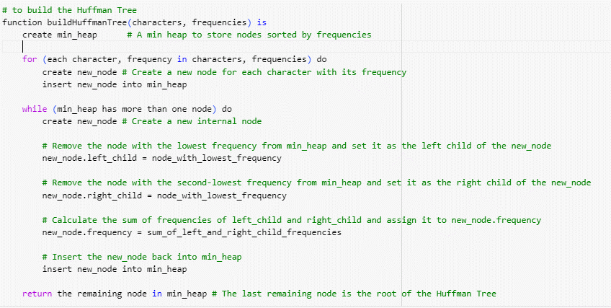
Huffman coding Pseudocode

Slide 48
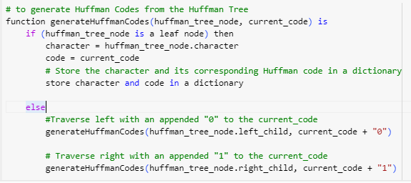
Huffman coding Pseudocode (contd..)

Slide 49
Time complexity of Huffman coding technique

Slide 50
Summary
Huffman coding is a technique used to compress files for transmission
Uses statistical coding
  more frequently used symbols have shorter code words
Works well for text and fax transmissions
An application that uses several data structures

